Slide 1

#LifeKoKaroLift
Practical session - 1

Slide 2




Topic Name- Version Control (GIT & GitHub)
Instructor- Vikash Dubey
EditEdit MasterMaster texttext stylesstyles

Slide 3
Today’s Agenda
Version Control (GIT & GitHub)
Making the project Remote
Accessing previous commit

Slide 4

Introduction to Version Control System
As a software engineer, your job is to build software using systematic, disciplined and quantifiable approaches.
So, you need to know about life cycles of
software development as it lays down a protocol
or in simpler words a sequence of steps to follow
while developing a product.

Slide 5
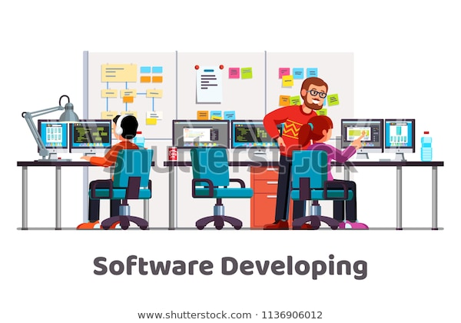
Introduction to Version Control System
Suppose you are software developer and working in a project team. Your job is to develop code for a
specific module on your project.
Initially, you’ll develop your code locally
on your system. If your project code is
getting bigger and bigger, you must maintain your code properly.

Slide 6

Introduction to Version Control System
You are working on your code and after making many changes you realise that you have really messed up or the current version of your code may have some issue and
now you want to revert to the last good version
of your project.
So, you won’t be able to do that if you have not
maintained history of each and every updates in a systematic way.

Slide 7
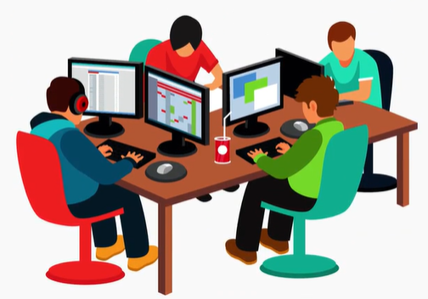
Introduction to Version Control System
In other scenario if you are working in a project team and develop a model with a group of team
members, every time you work on the \
project you should know exactly what
has already been completed, added,
changed and so on.

Slide 8
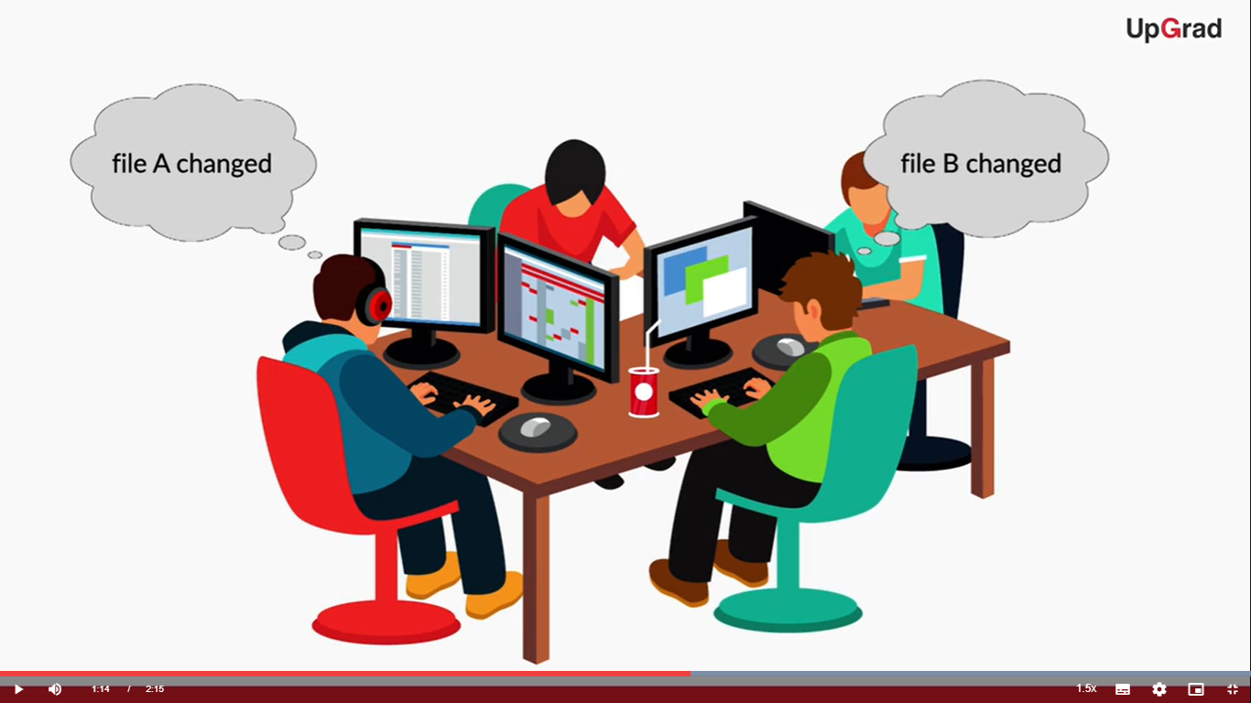
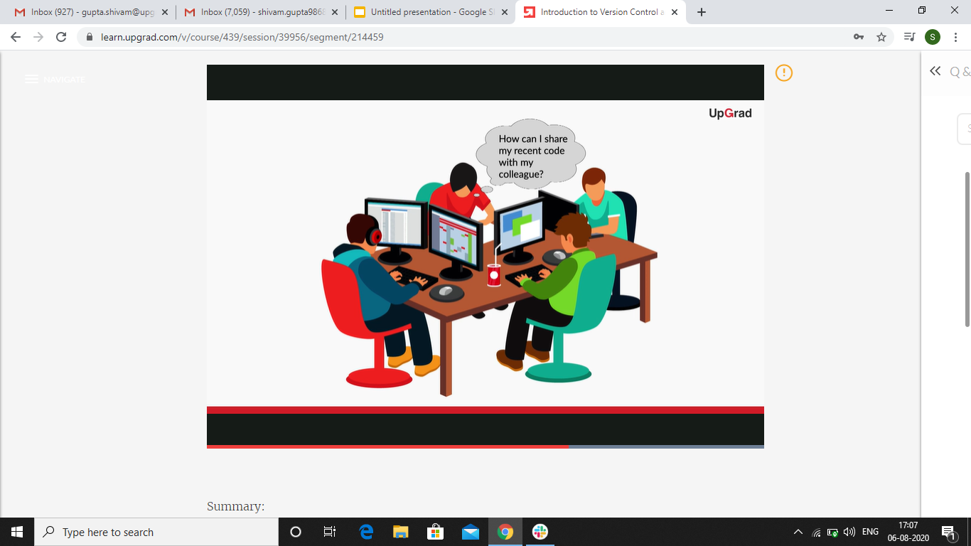
Introduction to Version Control System
How would you know who made the changes and which files were changed? How would you share your recent code update to your team member?

Slide 9
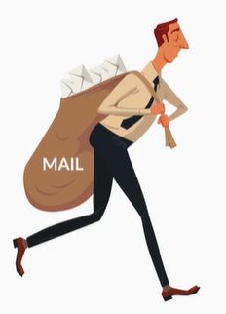
Introduction to Version Control System
One way is that you can compress your code with all the necessary artifacts and send every updates through email so that others can start work with the model. But this will be a very hectic and error prone way.

Slide 10
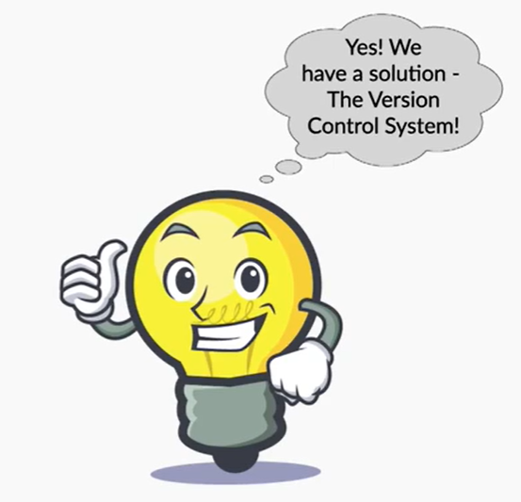
Introduction to Version Control System
So, is there any better solution to share the code to others and maintain history of each and every updates in a systematic way.
Yes, the solution to this is Version Control
System.

Slide 11

Version Control System
Version control helps a developer or a team of developer to track changes in their code and share the developer code with other team members.
This is done to improve the development
communication between them. Basically,
version control can help you solve most of
the problems that you have been facing with managing and sharing your files.

Slide 12
Version Control System
Version Control System
Version Control is a system that records or keeps track of the changes to a file or set of files over time so that you can recall or go back to specific versions later.
Version Control System is the management of changes to collection of information like documents, project code. It can track collaborative changes of your project.

Slide 13
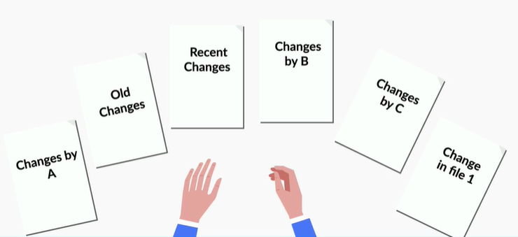
Version Control System
Also, developers can view the past versions of the code and the difference between them.

Slide 14
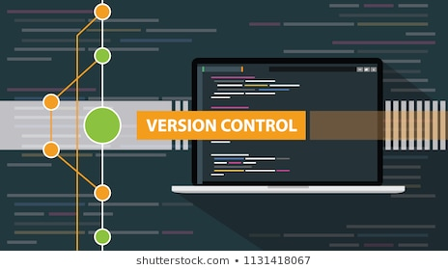
Types of Version Control System
There are two types of Version Control Models:
Centralized
Distributed

Slide 15

Centralized Control System
Centralized Control System
The centralized control system is working as a client server model. Here we have one
centralized server and a
localized repository file
system that is accessible
by a number of clients.

Slide 16
Centralized Control System
The advantages of this model are simplicity and ease of use.
One of the example of this model is subversion. So, google doc is an example of centralized version control system because Google doc only keeps one file for the word doc and everyone works on that one file.
Therefore all the changes and modifications will get stored and reflected on that one common file.

Slide 17
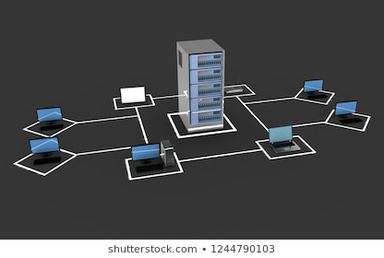
Centralized Control System
In subversion, there is only one repository file system usually stored on a network server.
Whenever you want to work on your
project you can connect the central file
system through network connection.
This leads to certain disadvantages.

Slide 18

Centralized Control System
Disadvantages of Centralized Control System
You cannot do any work on your project without a network connection.
If anything happened to the central file
system you may lose your data and history
of the changes.
The advantages of the centralized system totally depends on the functionality of the single server.

Slide 19
Distributed Control Systems
Distributed Control Systems
It takes a peer-to-peer approach to version control as opposed to the client-server approach of centralized systems.
In this model all the developers have their own local file system and changes between file systems are implemented locally on their machines.

Slide 20
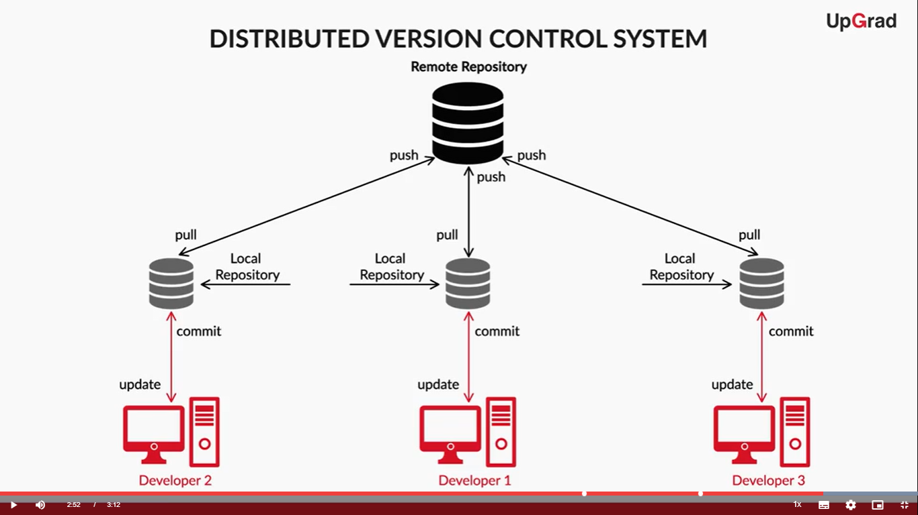
Distributed Control Systems
Examples of Distributed Control Systems are Github & Mercurial.

Slide 21

Distributed Control Systems
Advantages of Distributed Control Systems
Faster Access
Ability to work offline
Does not rely on a single location
for backups

Slide 22
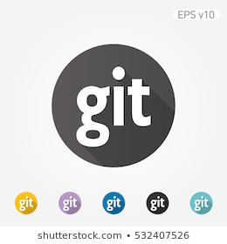
Advantages of Git over Mercurial
Advantages of Git over Mercurial
Git is faster than mercurial for network operations such as downloading and uploading project files
to the file server.
Git's approach to branches are more
powerful than mercurial.

Slide 23
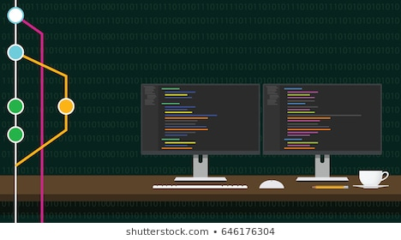
Advantages of Git over Mercurial
Git is more powerful for larger projects.
Git is one of the most widely used
popular version control system in
use today.
Git is open source and you can create a public or private file system which can be accessible by your project team.

Slide 24

History of Git
History of Git
Git was invented by Linus Torvalds. Linus is also the father of Linux Operating System and still he
maintains the Linux Operating System
Kernel.
Kernel is the heart of the Linux operating system the latest Linux kernel 4.13 has around some 60000 files and over 24 million lines of code.

Slide 25

History of Git
Approximately, 3500 lines of code are added into the line of Kernel Source code everyday. More that 1681 developers are involved from 225 companies. New
version of the Linux Kernel is released
in every quarter.
To maintain such lengthy code which is being worked upon by thousand of developers, there was a need of tool.

Slide 26
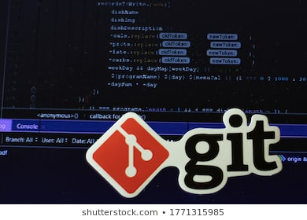
History of Git
A tool which could manage such a lengthy code and make collaborations between developers across different places and companies efficient and easy.
Hence, Git was invented to maintain
Linux Kernel. Git makes collaborations
as quick as and as painless as possible.

Slide 27
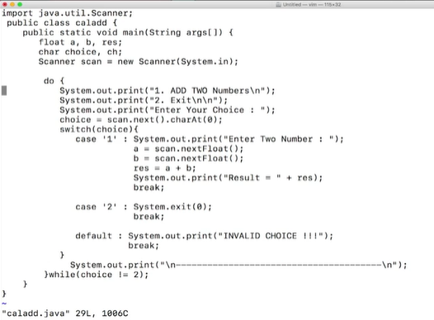
Demo Source Code
Demo Source Code

Slide 28
Demo Source Code
Case 1 is the code to add two numbers and Case 2 if for exit.
It is a menu driven program.
This program is compiled using Javac compiler.
Syntax: javac filename
Here, javac caladd.java

Slide 29
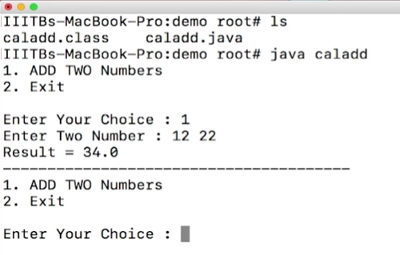
Demo Source Code
After the program is compiled, it is executed using Java command.
It displays both the cases. You
have to choose between one of
them by pressing 1 or 2.
Pressing 1 allows you to input the two numbers whose addition has to be done.

Slide 30
Purpose of Git
Now, suppose you want subtraction of two numbers instead of addition. So, you have to change the functionality of the code.
Suppose there are some errors while compiling the code and you are facing problems resolving those errors. So, instead of writing the code from scratch, you would want to visit the previous version of the code.
But, you can’t do it here as you have changed the code without maintaining any history. So, Git will help you out here.

Slide 31
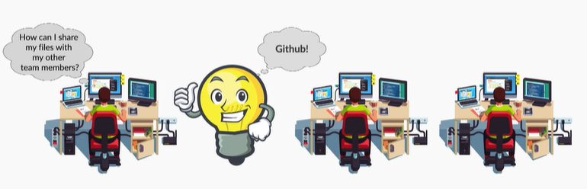
Introduction to Github
So far you know that you can have files on your local system. Is there a way by which you can share your files with your team or team members?
Well, yes. To do so,
you’ll need a web-based
Git, file hosting service.
One such service is
Github.

Slide 32

Introduction to Github
Github
Github is one of the most popular Git hosting services today. Using Github one can share their file system like files, documents or any image files with
others.
It helps a developer to access other users’
file system and store remote files and projects of other developers on his local system.

Slide 33
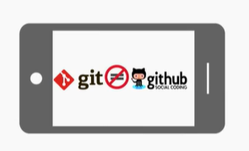
Differences between Git & Github
Differences between Git & Github
Git is a distributed version control
system. It is a tool to manage your
project source code history whereas
Github is a web-based Git file hosting
service which enables us to showcase
or share our projects and files to others.

Slide 34

Introduction to Repository
What is a Repository
In order to transfer your file systems from your local system to Github, you would need a container or a
directory to which you can store and
transfer all the contents from local
systems to Github.
This container or directory which contains your project files is known as a Repository.

Slide 35

Stages of File in Git
A file in git can be in three stages:
Modified
Staged
Committed

Slide 36

Modified Stage
Modified Stage
When you first make changes to your file, the changes will exist only on your local computer in your
working directory.
Git has not yet tracked the changes or
modifications to those files.

Slide 37
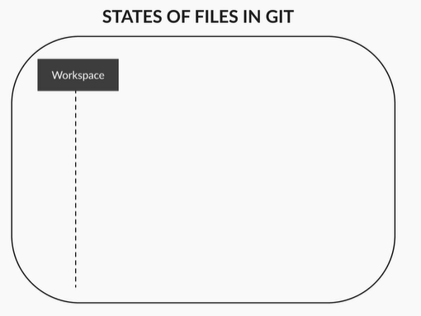
Modified Stage
In other words, these files and changes are not yet part of your development history or not visible to anyone except you.

Slide 38
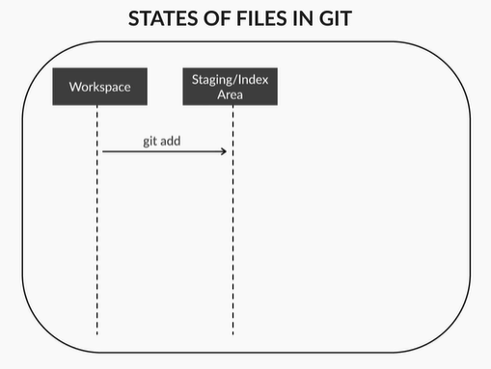
Staged
Staged
You tell git to add any files or
changes that you want to include
in your development history. So,
git knows which files and
changes it should track.
The files that you add to your development history at this stage goes to something called the staging area.

Slide 39
Committed Stage
Committed Stage
After doing your review, you can then decide which changes you want Git to permanently track before saving those file and files changes permanently to your development history.
Once you are sure about your staged files, you can make a record of your changes and Git will remember those changes.

Slide 40
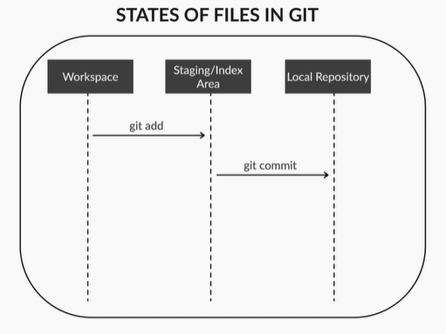
Committed Stage
Files and changes stored in the
staging area are not yet
permanently tracked in your
development history.
Rather, the staging area is used
by you to review all the files
and the changes that you have made.This is known as a commit.

Slide 41

Commits in Git
Characteristics of Commits in Git
There can be a number of commits for your project or code. Each commit might
happen at a particular time
stamp.
The timeline of commit creates
a graph. Commit creates links to other commits forming a graph of your development history.

Slide 42
Commits in Git
You can revert back to your previous commit, see how files changed from one commit to next, even fix bugs in any of the commit and review information such as where and when changes were made.
Commits are identified in git by a unique id which is assigned to them by as soon as they are made.

Slide 43
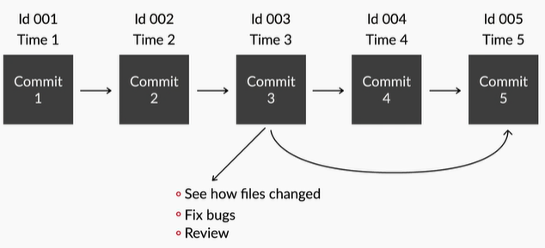
Commits in Git
Commits in Git

Slide 44

Connecting Project to a Github Repository
So far, you must be having a picture in your head as how your file moves between different stages from your local computers to become a repository on Github.
It's time to now see how can you connect
a project on your local system to a
repository on Github.

Slide 45
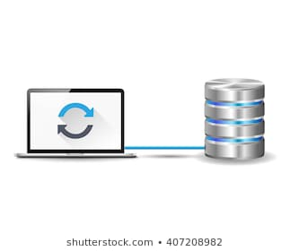
Connecting Project to a Github Repository
Steps to Connect a Project on your Local System to a Repository on Github
Signing up for github.
Initializing a git repository.
Configuring git for the very first time.

Slide 46
Connecting Project to a Github Repository
Making a commit.
Putting up your project on github.
Making some modifications to your project and updating on github.
Accessing your previous commits

Slide 47

Connecting Project to a Github Repository
Step 1: Signing up for Github
You will open the link Github.com and then go
for sign up.
You’ll have to choose your unique username.
You’ll have to specify your email address.
They’ll send you a verification link on this email id where you’ll have to verify to activate the account.

Slide 48
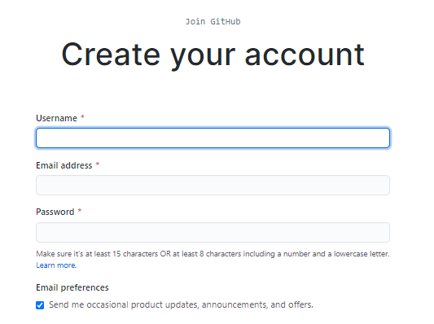
Connecting Project to a Github Repository
Then, you’ll have to choose your password.

Slide 49
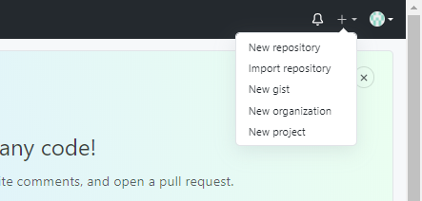
Connecting Project to a Github Repository
Step 2: Initializing a Git Repository
You’ll login into your Github account.
You’ll create a new repository by
clicking on the new repository button.
You’ll give a name to your repository let’s say Project 1.

Slide 50
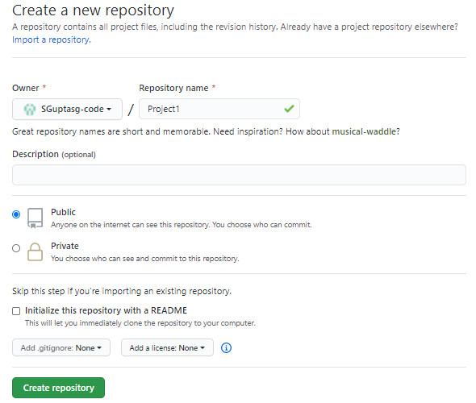
Connecting Project to a Github Repository
You’ll make your repository
public so that your team
members or anyone can see
the source code.
Then you’ll click on Create
repository button.

Slide 51
Connecting Project to a Github Repository
Step 3: Configuring Git for the very first time
If you are working with Git for the very first time, you’ll have to run certain commands to configure Git to link it to your Github account.
git config --global user.name "random”
Using this, you will enter your GitHub username

Slide 52
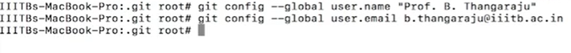
Connecting Project to a Github Repository
git config --global user.email “random@example.com”
Using this, you will enter your GitHub username

Slide 53
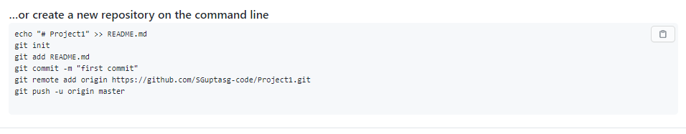
Connecting Project to a Github Repository
Step 4: Making a commit
You’ll go back to your Github page and execute the commands being shown on the command line.

Slide 54
Connecting Project to a Github Repository
git init
This command helps you in creating an empty Git
repository.
git add filename
It tells git to add the newly created file to the staging area.
git commit -m “commit message”
It helps you to give a meaningful message inside double quotes.

Slide 55

Connecting Project to a Github Repository
Importance of Commit Message
It is important to write good commit messages when you are working in your team.
Commit message would help other members
on your team understand what files you
created or what changes you made to the files.
The commit message can also be used to remind you what changes you had made with a specific commit.

Slide 56

Connecting Project to a Github Repository
Step 5: Putting up your Project on Github
git remote add origin <url of the remote repository>
This command gathers all the committed
files from your local repository and uploads
them to our repository we created on github
account. Not all files are included in the upload. Only new files and files that contain changes get uploaded.

Slide 57
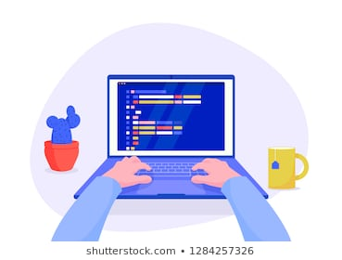
Connecting Project to a Github Repository
git push -u origin master
This command will push all your local changes to your online repository that is your repository on
Github.
Git push tells git that you want to upload
your files and development history from the repository on your local computer to a repository hosted on github.

Slide 58
Connecting Project to a Github Repository
-u option will tell you they want to upload the master version of your commits to a repository on github called origin. Origin is simply an alias for your github repositories address on github.
Github automatically linked your remote repository address to the alias origin when you installed github. You can change origin to whatever github repository address you would like.

Slide 59
Linking Calculator.java File to Git Repository
So far, you have seen the first 5 steps that you need to perform to connect a project on your local system to a repository on Github.
Now, it’s time to learn to make modifications to your files and add them again to GitHub. Let us first add a file Calculator.java in the local repository and then link it to the remote repository on Git.

Slide 60
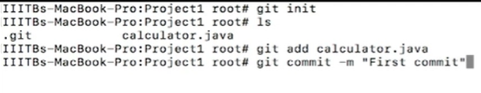
Linking Calculator.java File to Git Repository
You’ll begin by executing the git init command to create a local repository in the present working directory.
Then you’ll add the Calculator.java file by git add command and add a commit message saying “First commit” using git commit -m command.

Slide 61

Linking Calculator.java File to Git Repository
Then, you’ll add the remote repository into your local repository using the git remote add origin “url” command.
Also, you’ll have to transfer the project from
the local repository into the remote repository
using the command git push -u origin master.

Slide 62
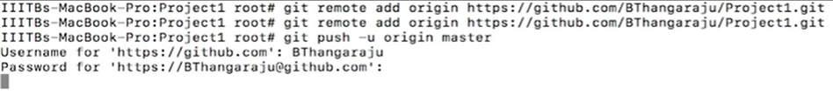
Linking Calculator.java File to Git Repository
This will prompt for your login credentials into your Github Account.
Then you’ll go back to your github account page remote repository and refresh it to see Calculator.java file on the page. On clicking the file you can get the complete source code of the file.

Slide 63
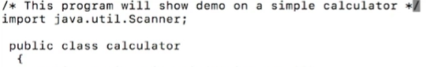
Modifying File & Updating to Github
Now, let’s modify the existing file.
Step 6: Making some modifications to your Project and updating on Github
You can modify your file by just adding some documentation into the project and saving it.
Then you’ll execute the git status command.

Slide 64
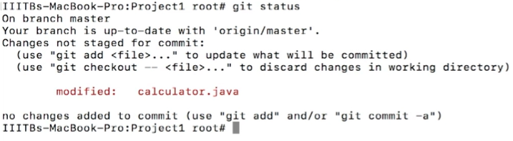
Modifying File & Updating to Github
git status
Displays the state of the working directory and the staging area. It lets you to see the changes which have been staged and which changes haven't been added to the staging area.
The calculator.java file
is in the project
workspace, but it still
has not been added to the staging area.

Slide 65
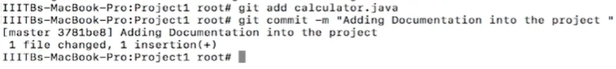
Modifying File & Updating to Github
So, to add the file Calculator.java to the staging area you’ll execute the command git add calculator.java.
Then you’ll
execute command
git commit -m “adding Documentation into the Project” to commit this message.
Then, you may see the Git status again to check whether everything is fine.

Slide 66
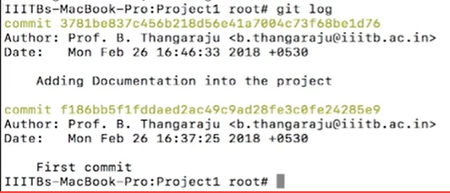
Modifying File & Updating to Github
Next, you can see the log
messages by executing the
command git log.
git log
git log files will show you the commit details. It lists out the commits made in the repository in reverse chronological order i.e the most recent commits show up first.

Slide 67
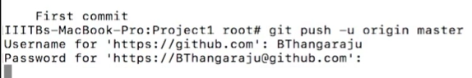
Modifying File & Updating to Github
Then you’ll run the command git push -u origin master and refresh the Github page to
see the uploaded
Calculator.java file with the Documentation in the source code.
It will ask for the login credentials. After giving the username and password you’ll be able to see the updated Calculator.java file.

Slide 68

Need to access Commits
Have you ever faced a situation where your code is suddenly not working after you’ve changed it? Showing you errors? To make things worse, you don’t know where
the bugs came in from?
But you remember that the last time you
saved the changes to your code, it was
working fine.

Slide 69

Need to access Commits
Wouldn’t it be great if you could somehow go back to the last working version of your code and start from where you left off instead of from scratch?
So, let us now see how to access your
previous commits.

Slide 70
Accessing Previous Commits
Step 7: Accessing your previous Commits
git log
It will show you the entire commit history for the project
It will show you the:
Commit id
The username
Mail id of the person who made the changes
Date & time when the commit was made.

Slide 71
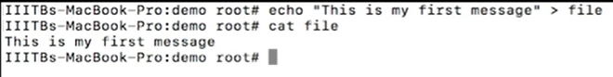
Undoing Changes in File
How to undo some bad changes in your file?
Suppose you create a
file using echo
command and add a message to the file.
echo “This is my first message”> file
You can see this message using the cat editor which enables you to see what’s there in a file.
cat file

Slide 72
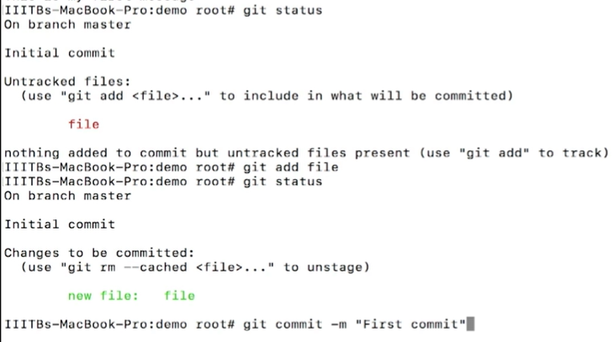
Undoing Changes in File
Then, if you check this file using the git status, you’ll see that you need to add this
file to the staging area
and also need to commit
a message. So you add
this file and then give
“First Commit” as your
commit message.

Slide 73
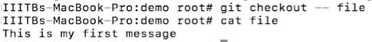
Undoing Changes in File
Now, you modify this file with some bad changes.
echo “bad changes…” >> file
Then, you have two options: either you can add this modified file to the staging area or you can use the git checkout command.
git checkout -- filename: This command helps you when you have made some changes to your file, and you haven’t added those changes to the staging area. Using this command will take you back to its previous state.

Slide 74
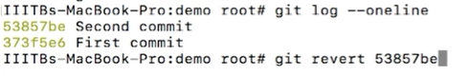
Undoing Changes in File
In other scenario, if you add the file to the staging area and you have commited into the local repository, then you have to use the git revert commit_id command. Note that you can get the commit ids using commands: git log & git log --oneline.
git revert commit_id:
This command helps you when you have already staged your files and committed the changes and want to go back to your previous commit.

Slide 75

Undoing Changes in File
Instead of removing the previous commit from the project history, git revert will figure out how to undo the changes introduced by the previous commit and
appends a new commit that reverts the
content and the changes introduced by the
previous commit.
This prevents git from deleting any commits, which is important to maintain the integrity of your revision history.

Slide 76
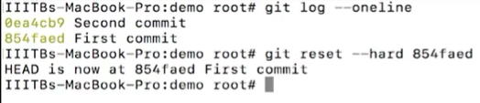
Undoing Changes in File
There is one more command named reset command which helps to undo the changes. It is more powerful command as compared to revert command.
git reset --hard commit_id
This command helps you when you have already staged your files and committed your changes, want to go back to your previous commit, and want to remove your present commit.

Slide 77

Undoing Changes in File
However, git reset --hard commit_id command is very dangerous. The reason is that when this command is executed, the head pointer is updated to that
specific commit.
Head is the pointer to the latest commit and
therefore any previous changes and modifications which were done will be removed.
Notes:
what will happen if you mistakenly delete the file from your local system?
This has to be shown. https://learn.upgrad.com/v/course/439/session/39956/segment/214463

Slide 78

Thank you!
#LifeKoKaroLift

